Slide 1
Weight Management ScaleFit
Made by Team 4

Slide 2
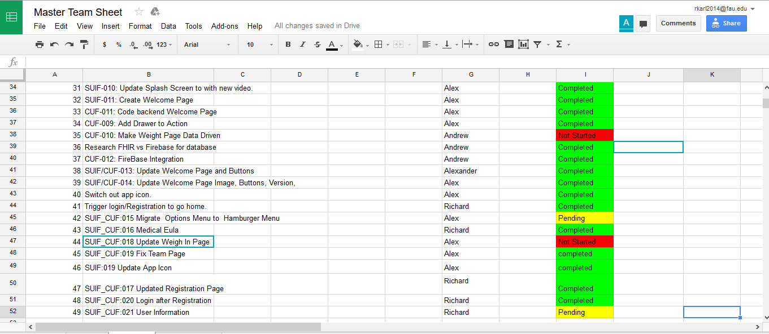
Task List

Slide 3
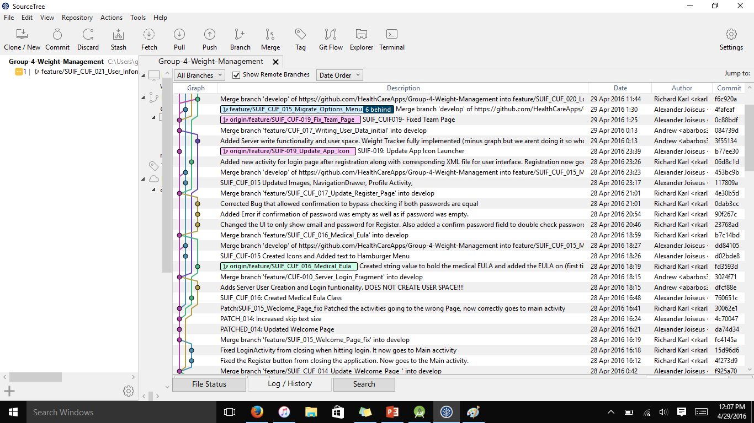
SourceTree

Slide 4
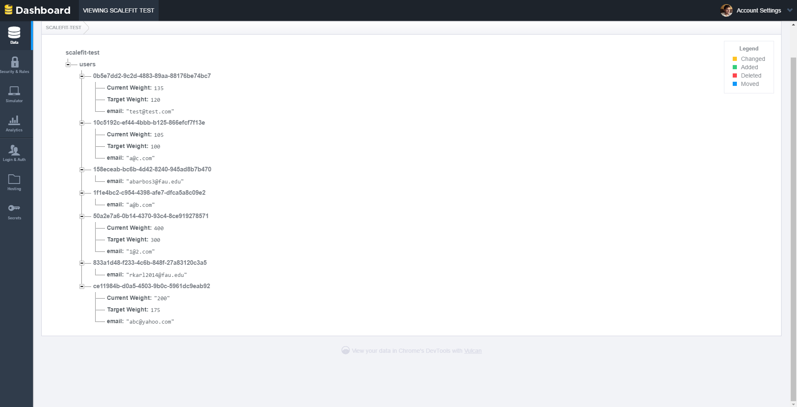
FireBase

Slide 5
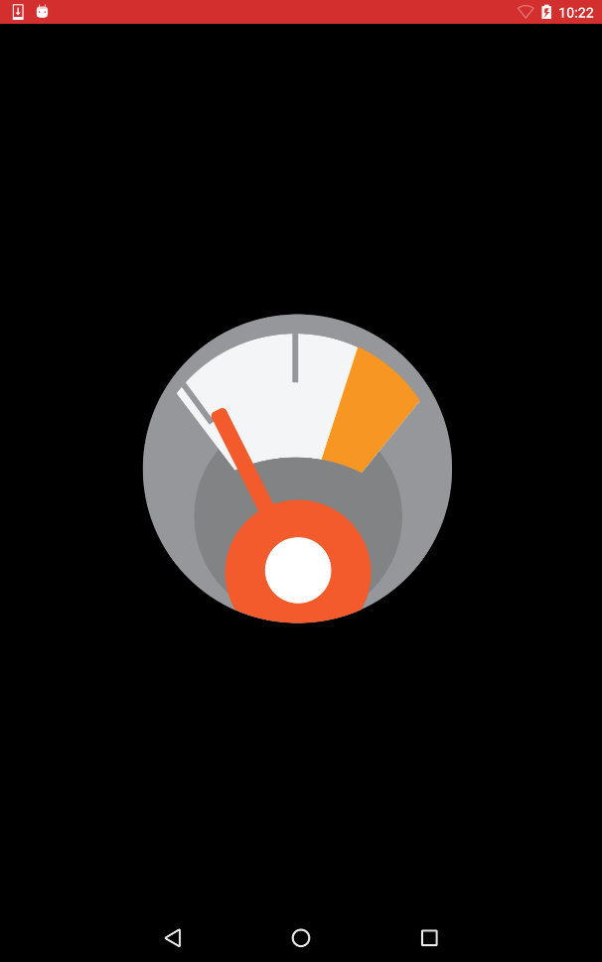
Splash Screen Animation

Slide 6
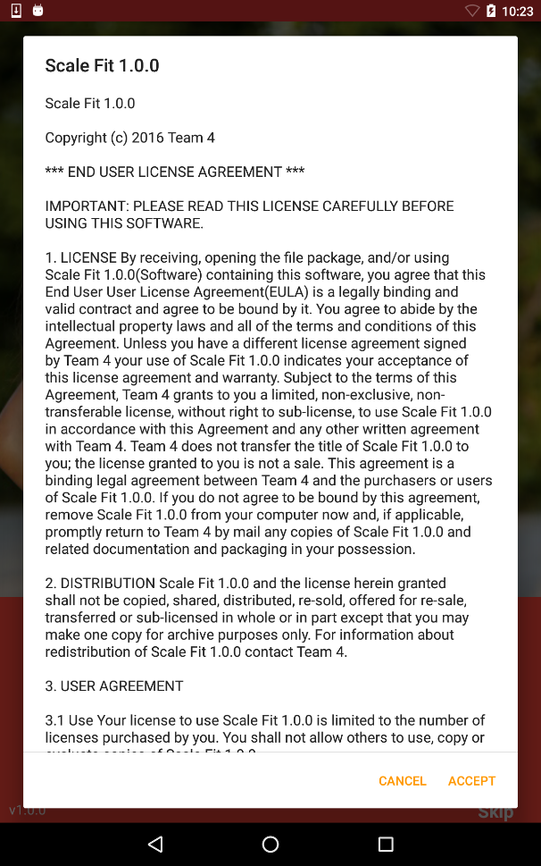
EULA - (End User License Agreement)

Slide 7
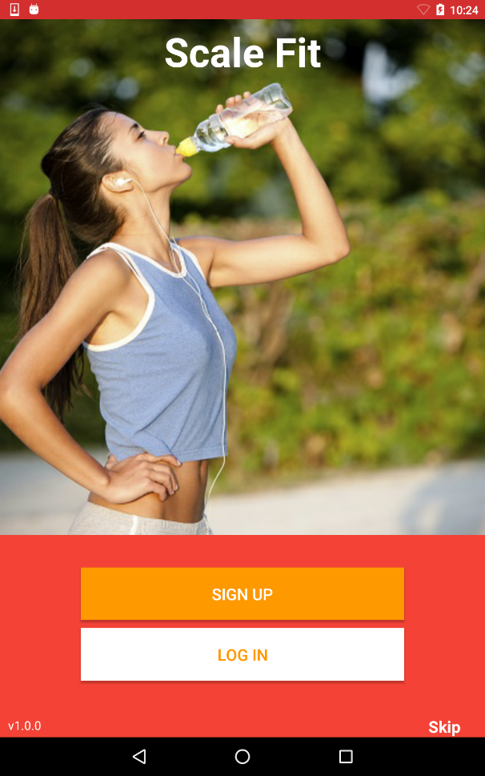
Welcome Screen

Slide 8
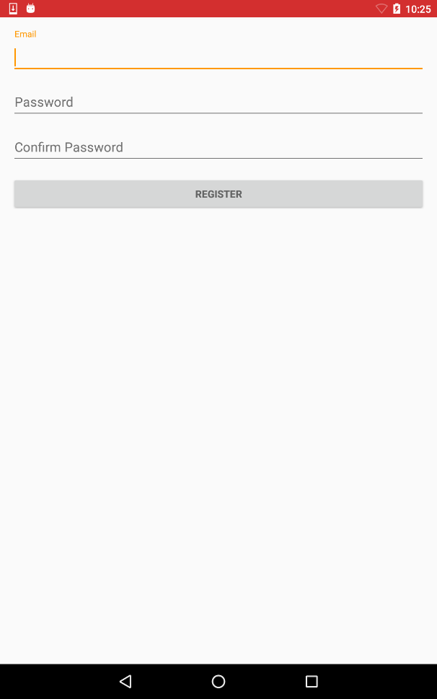
Registration Screen

Slide 9
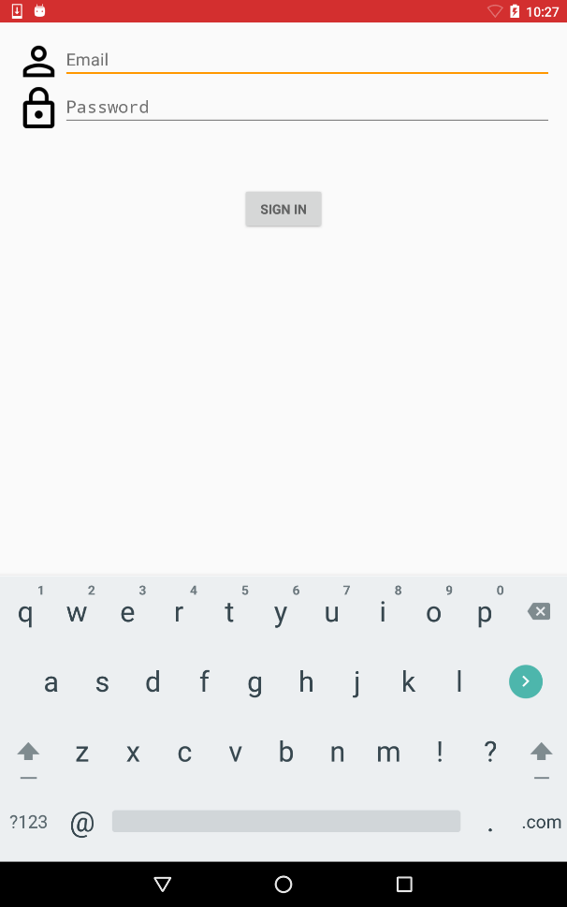
Login (After Registration)

Slide 10
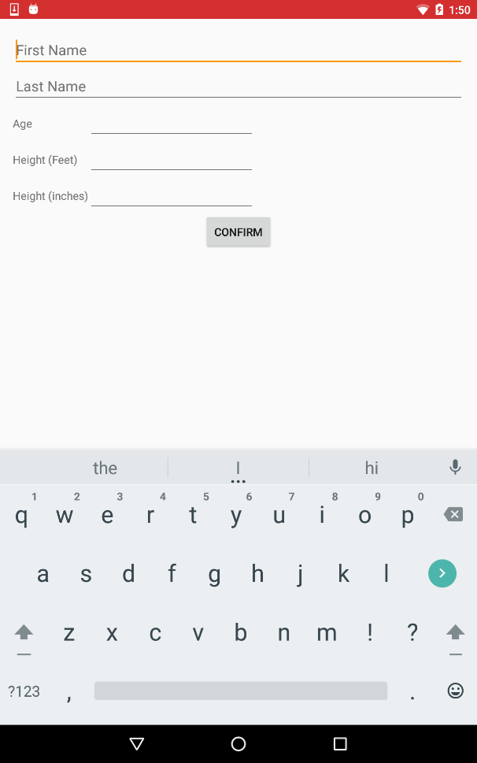
User Information Screen

Slide 11
Login (Existing User)

Slide 12
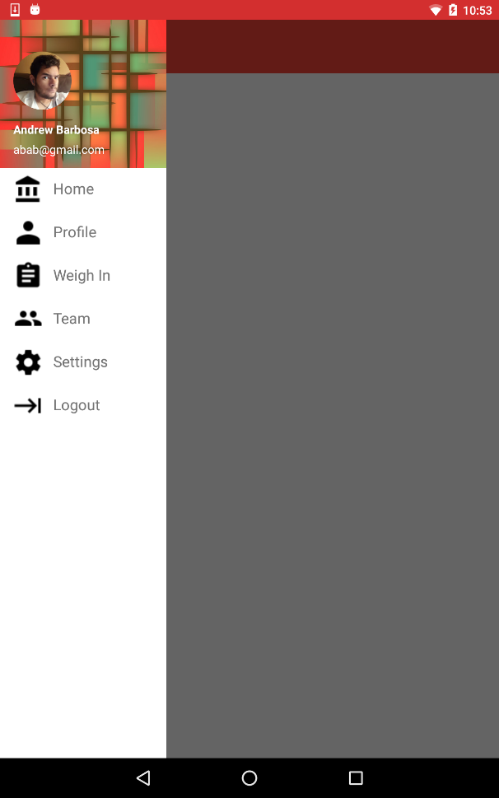
Main Screen (w/ Hamburger Menu)

Slide 13
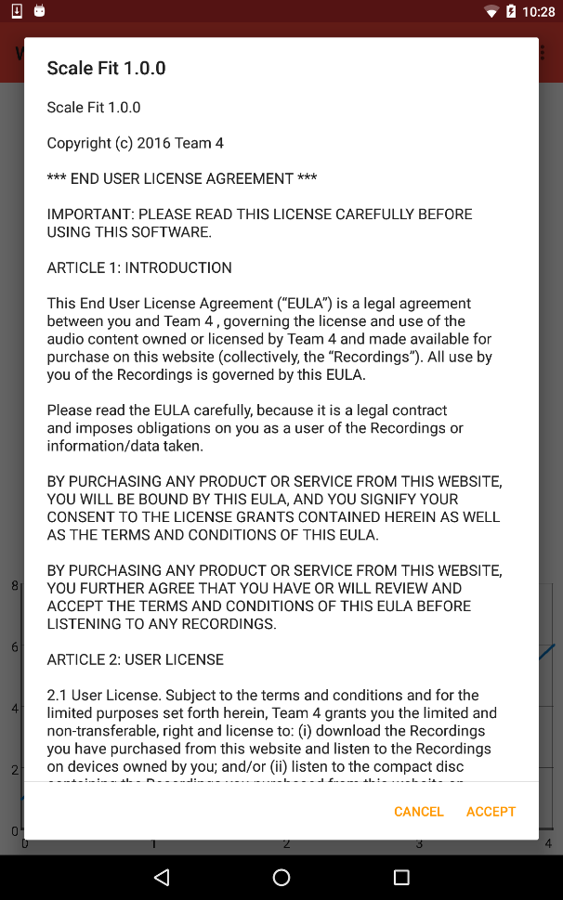
Medical EULA

Slide 14
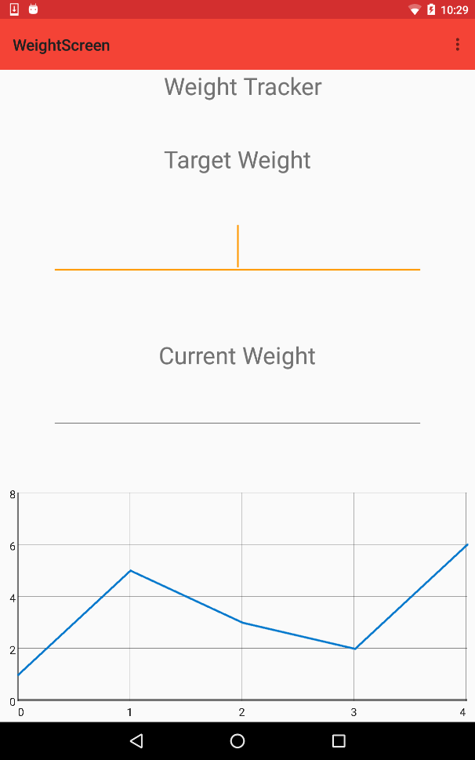
Weight Screen

Slide 15
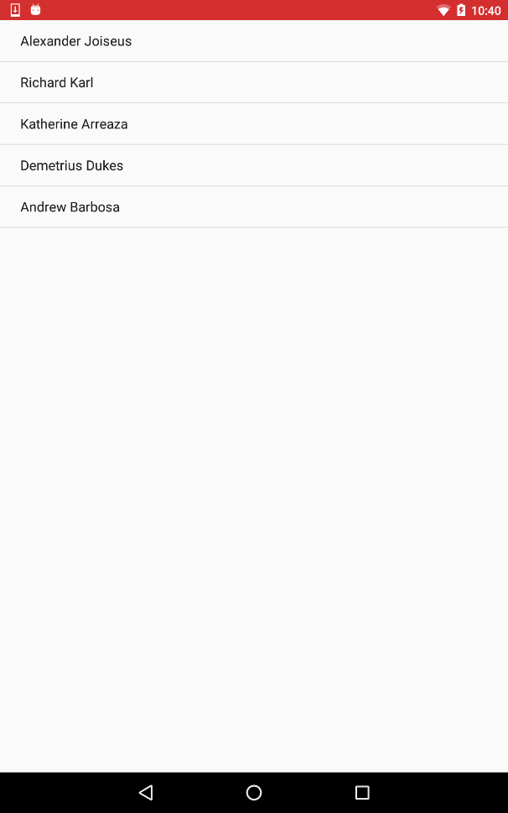
Team Bio Screen

Slide 16




Design Software
Design influence for the app was influenced by Googles material design
Balsamiq:
App moc-up
Adobe Illustrator:
Logo Design/ Asset design
Adobe Photoshop
Page layout
Adobe After Effects
Video

Slide 17






App Icon development

Slide 18
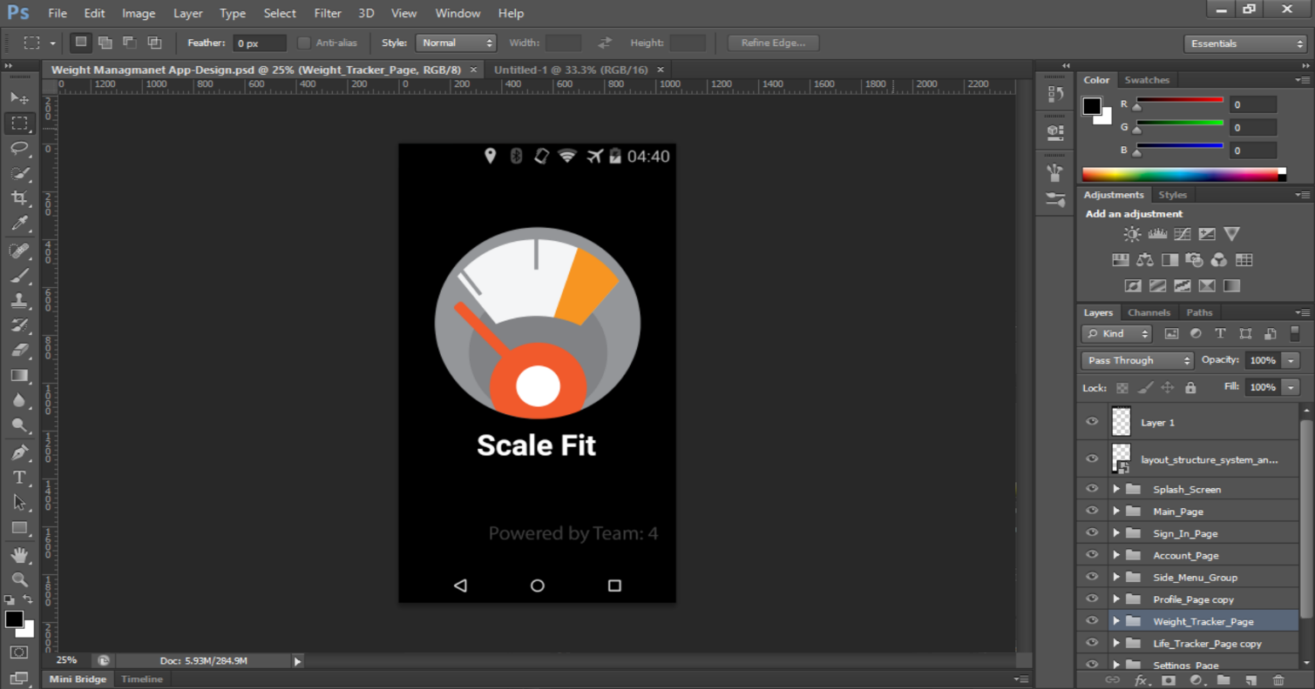
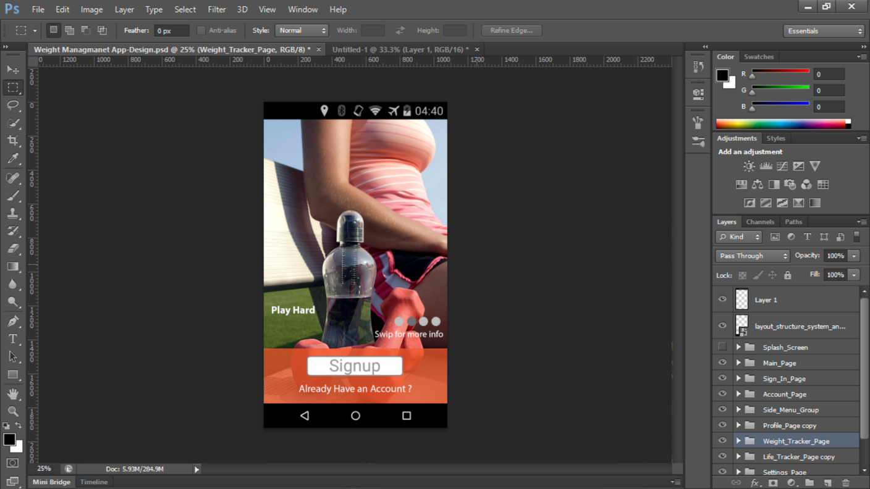
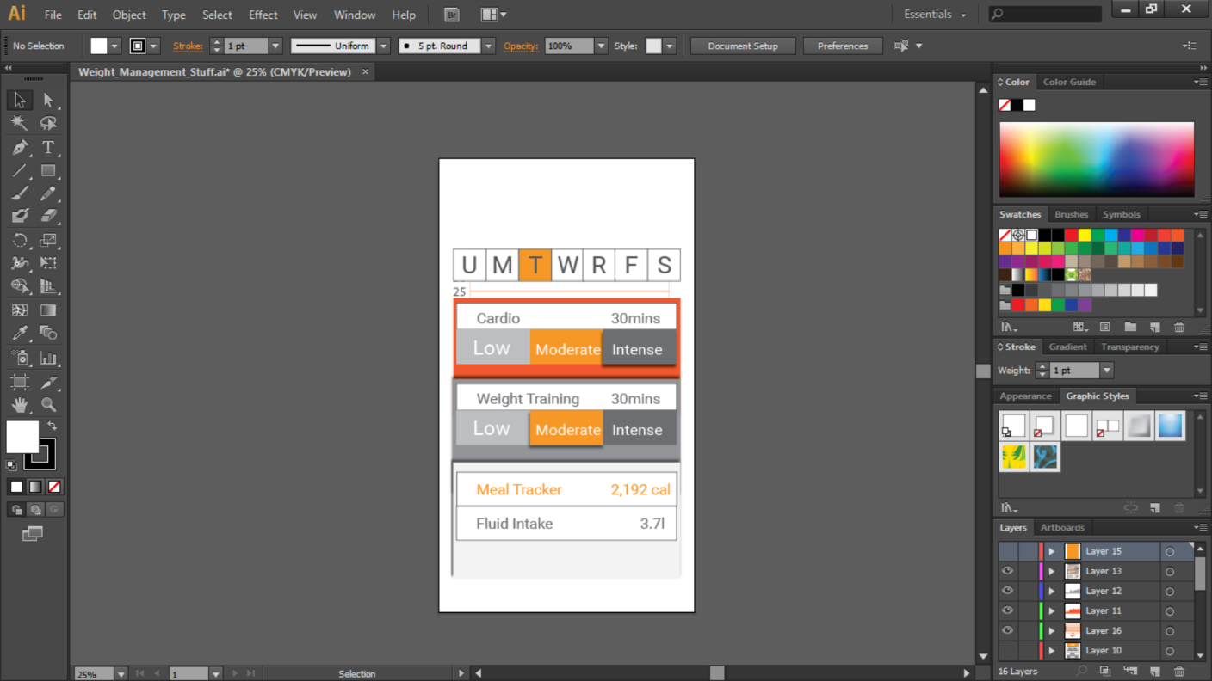
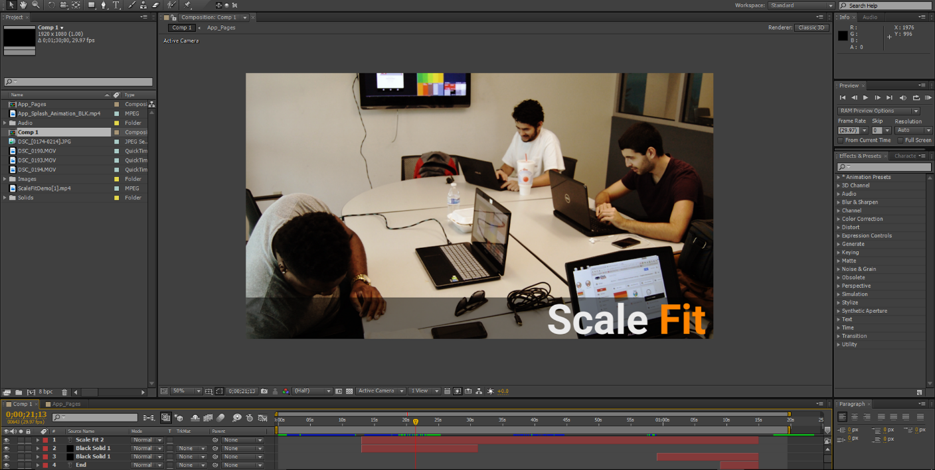

Slide 19
Thank You

